Slide 1
Securing Linux
CyberCamp 2019
Ricky Payne CISSP, AWS CSA, RHCE, RHCSA, Security+ , BS-IST, AS-CET

Slide 2

About Me
Over 13.5 years of progressive DevSecOps experience from Intern to Security Analyst -> Architect -> CSO -> Sr. Eng
Built and operationalized vuln mgmt process for 1000s of globally distributed machines
Built “Gold Standard” federal security programs that produced 10+ federally certified systems.
Expert generalist: from pre-sales proposal work, policy and reference architecture development, requirements decomposition into agile sprints, proof of concepts, implementation, operations, and technical training to incident response.
Mentored/taught Windows and Linux security at CyberPatriot/CyberCamps since 2013. Accomplishments include 1st and 2nd in State and 1st in Regionals.
As a Sr. SecEng for a global, Silicon Valley InsureTech firm, engaged in all SecOps activities for 1000s of heterogeneous machines across multiple cloud technologies
Ricky Payne
CISSP, AWS CSA, RHCE, RHCSA, Security+, BS-IST, AS-CET
grep.rickp@gmail.com
@RickPayne929

Slide 3
Agenda
Linux 201 Overview
Users, Groups, Passwords
Package Mgmt, File Permissions
Services / Daemons
Port scans, Port monitoring
Firewall
Audit Logs: /var/log/messages,auth.log
Security Guidance
Your mission…

Slide 4

Linux 201

Slide 5
Linux 201
This course is advanced and will be fast paced
The course intent is to be practical with open discussions
Please pay attention and keep up the best you can
Let’s begin!

Slide 6
Common Commands
Command | Description | Example
<cmd> --help | Command usage / syntax | cat --help
apropos <key word> | Query manual pages for <keyword> | apropos password
man <cmd> | Manual page for <cmd> | man passwd
sudo | Act as another user | sudo cat /etc/passwd
grep | search for a string in a file | sudo cat /var/log/secure | grep failed
vi | Launch vi | vi /tmp/vitest
find | Find a file in the FS | sudo find / -type f -perm 0777
cat | print a file to the screen | cat /etc/passwd
tail | Print the bottom of a file (-f to follow!) | sudo tail –f /var/log/secure

Slide 7

Users, Groups, Passwords

Slide 8
User, Groups, Passwords
Setting the stage:
What users are on my system?
What users are in what groups? Admin? Sudo?
Is the root account locked?
Anything suspicious in the sudoers file?
Do all authorized users have a complex, strongly hashed, aging password?

Slide 9
User, Groups, Passwords - Add user/group, check root/sudoers
Let’s create a user, add him to a group, and check root account status and sudoers
From the terminal(sudo as needed):
adduser yourname (use cybercamp for password)
adduser yourname sudo, usermod –a –G sudo yourname
addgroup testgroup
su yourname
Verify from terminal with:
id yourname
groups yourname
Root status, sudoers check:
Passwd –S root
less /etc/sudoers
Create a badguy user and add him to the sudo group

Slide 10

User, Groups, Passwords GUI
You can do the same via GUI
From System -> Administration -> Users and Groups
Terminal: users-admin

Slide 11
Users, Groups, Passwords /etc/passwd /etc/shadow
/etc/passwd entry
/etc/shadow entry
chage –l yourname
$1 = MD5, $6 = SHA512
user password UID GID name home shell
user sha256 password hash ‘Last pass change’ Min Max Warn

Slide 12
User, Groups, Passwords Hash, Aging
From the terminal(sudo as needed):
vi or gedit /etc/pam.d/common-password
Remove sha512, exit via :wq or save and close
passwd yourname
tail /etc/shadow
chage –l yourname
chage –M 60 –m 7 –W 7 yourname
tail /etc/shadow
vi or gedit /etc/pam.d/common-password
Add sha256, exit via :wq or save and close
passwd yourname
tail /etc/shadow

Slide 13
User, Groups, Passwords Complexity
From the terminal(sudo as needed):
sudo apt-get install libpam-cracklib
vi or gedit /etc/pam.d/common-password
password requisitie pam_cracklib.so line
dcredit=1 ucredit=1 lcredit=1 ocredit=1
password pam_unix.so line
remember=24

Slide 14

Package Mgmt, File Permissions

Slide 15
Package Mgmt, File Permissions Apt-file, Updates
Let’s install a package and prepare to update From the terminal(sudo as needed):
apt-get install apt-file
apt-file update
apt-get update
apt-get upgrade (Press N! for now)
Package Management via GUI:
System > Administration > Update Manager

Slide 16
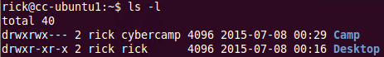
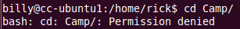
Package Mgmt, File Permissions chmod, chown, chgrp
Let’s review our home folder’s permissions, set cybercamp as the group for the Camp folder, and deny others access.
From the terminal(sudo as needed):
ls -l /home/yourname
mkdir ~/Camp
chgrp cybercamp ~/Camp
chmod 770 ~/Camp
4 – Read
2 – Write
1 – Execute

Slide 17

Services / Daemons

Slide 18
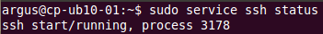
Services / Daemons
Let’s disable/enable a service identified in our port probing
From the terminal(sudo as needed):
Apt-get install ssh
service ssh status, stop, start, restart
apt-get install sysv-rc-conf chkconfig
sysv-rc-conf –list, or chkconfig --list
sysv-rc-conf ssh on, or chkconfig ssh on
sysv-rc-conf ssh –list, or chkconfig ssh –list
service ssh start
lsof –i :22
ps aux | grep ssh or PID

Slide 19
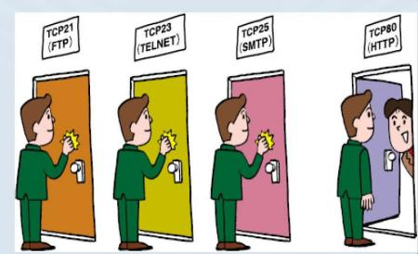
Port scan, Port monitoring

Slide 20
Port scan, Port monitoring
Let’s identify the system’s open ports
From the terminal(sudo as needed):
apt-file search /usr/bin/nmap
apt-get install nmap
Ifconfig
Note inet addr:
sudo nmap –p 1-1024 <inet addr noted above>
Note open ports
netstat –tuln
service ssh stop
Press up to rerun nmap and netstat again
What happened?
Network tools GUI:
System > Administration > Network Tools
gnome-nettool

Slide 21
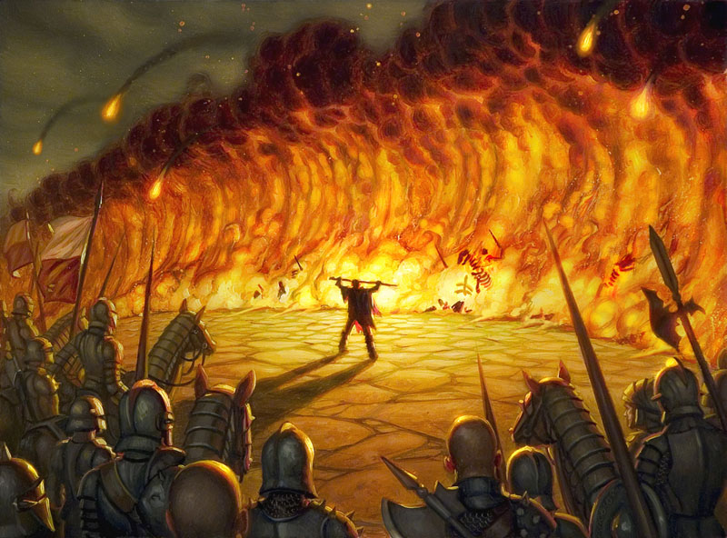
Firewall

Slide 22
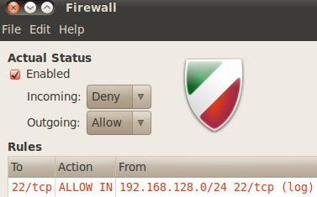
Firewall
Let’s enable Ubuntu’s uncomplicated firewall and add a network specific SSH exception
From the terminal(sudo as needed):
apt-get install gufw
gufw
Click: Enabled
Add
Check: Show extended actions
Click: Advanced tab
0, Allow, In, Log, TCP, From 192.168.128.0/24: 22, To blank: 22
Click: Add
ssh user@myIP
Success? Let’s see what happened

Slide 23

Audit Logs

Slide 24
Audit logs
Let’s investigate the logs to see what happened
From the terminal(sudo as needed):
less /etc/rsyslog.conf
tail /var/log/auth.log
grep -i fail !$
tail /var/log/messages or tail /var/log/syslog
Any ideas?
gufw
Click add
Check: Show extended actions
Click: Advanced tab
0, Allow, In, Log, TCP, From 192.168.128.0/24: 22, To blank: 22
Click: Add
ssh user@myIP
Success?

Slide 25
Security Guidance
DISA STIGs - http://iase.disa.mil/stigs/Pages/index.aspx
CIS Benchmarks - https://benchmarks.cisecurity.org/

Slide 26
What we learned…
Some common commands in the console
Understanding users, groups and passwords
Auditing and modifying file permissions
Basic package management
Starting and Stopping Daemons
How to identify open network ports
Understanding firewall configuration
Using the audit logs
Security Guidance

Slide 27

Your Mission…

Slide 28
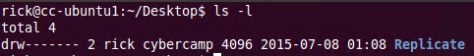
Your mission….
Delete the testgroup
Remove badguy from the sudo group
Lock the badguy account
Install vsftpd
Ensure the service is started
Ensure the service persistently starts
Identify which port was opened
Add the port exception to the firewall
Replicate the following perms → →
Set the cybercamp’s password to
expire in 60 days, 1 day minimum change and a 15 day warning
Configure the system password hash to sha512
Perform package upgrades

Slide 29
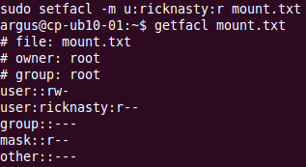
Package Mgmt, File Permissions BACKUP - setfacl
Let’s configure the file system ACL option, create mount.txt, set root as the owner and group, deny others access, but allow yourname to read via setacl permissions
From the terminal(sudo as needed):
vi or gedit /etc/fstab
Add acl, option after ext4 and separate via ,comma,
reboot
mount > mount.txt
cat mount.txt | grep acl
ll mount.txt
chown root mount.txt
chgrp root mount.txt
chmod 600 mount.txt
getfacl mount.txt
setfacl –help
setfacl –m u:yourname:r mount.txt
getfacl mount.txt

